Slide 1
Operators and Expressions

Slide 2
Introduction
Operator: A symbol that tells the computer to perform certain mathematical or logical manipulations
C offers rich set of built-in operators
Arithmetic
Relational
Logical
Assignment
Increment and Decrement
Conditional
Bitwise
Special
Expression: Sequence of operators and operands that reduces to a single value
E.g. 10+15

Slide 3
Arithmetic Operators
Operator | Meaning
+ | Addition or unary plus
- | Subtraction or unary minus
* | Multiplication
/ | Division: integer division truncates any fractional part
% | Modulo division: produces remainder of an integer division Operands must be integers

Slide 4
Integer arithmetic
When both operands in a single arithmetic expression are integers
Always yields an integer value
If a=14 and b=4 what is the result of following expressions?
a-b
a+b
a*b
a/b
a%b

Slide 5
Integer arithmetic…
When both operands in a single arithmetic expression are integers
Always yields an integer value
If a=14 and b=4 what is the result of following expressions?
a-b yields 10
a+b yields 18
a*b yields 56
a/b yields 3
a%b yields 2

Slide 6
Integer arithmetic…
In modulo division, the sign of the result is always the sign of the first operand
i.e. -14%3 yields -2
-14 % -3 yields -2
14 % -3 yields 2

Slide 7
A Program to illustrate integer arithmetic to convert number of days into months and days

Slide 8
A Program to illustrate integer arithmetic to convert number of days into months and days
main()
{
int months, days;
printf(“Enter number of days\n”);
scanf(“%d”,&days);
months = days/30;
days = days % 30;
printf(“The number of months are %d and number of days are %d\n”,months,days);
}

Slide 9
Real arithmetic
involves only real operands
since the floating point values are rounded to the number of significant digits permissible, the final value is an approximation of the correct results
if x,y and z are floats, then we will have,
x=6.0/7.0=0.857143
y=1.0/3.0=0.333333
z=-2.0/3.0=-0.666667

Slide 10
Mixed-mode arithmetic
When one of the operands is real and other is integer, the expression is called a mixed-mode arithmetic expression
if either operand is of real type, then only real operation is performed is result is always a real number
e.g. 15/10.0 = 1.5
15/10=1

Slide 11
Relational operators
To compare two quantities and depending on their relation, take certain decisions
Comparison can be done with relational operators
A value of relational expression is either 1 or 0 i.e. TRUE or FALSE
A simple relational expression
ae-1 relational operator ae-2
E.g.
4.5 <= 10 yields TRUE
4.5 < -10 yields FALSE
-35 >= 0 yields ?
10 < 7+5 yields ?
a+b > c+b yields ?

Slide 12
Relational operators
Operator | Meaning
< | Is less than
<= | Is less than or equal to
> | Is greater than
>= | Is greater than or equal to
== | Is equal to
!= | Is not equal to

Slide 13
Logical operators
When we want to test more than one condition and make decisions
A logical expression always yields a value or 1 or 0.
re-1 logical operator re-2
E.g.
a>b && x==10
Truth table
Operator | Meaning
&& | Logical AND
|| | Logical OR
! | Logical NOT

Slide 14
Assignment operators
Used to assign the result of an expression to a variable
v = exp;
Short hand operator
v op= exp; is equivalent to v=v op (exp);
E.g.
x +=3;
x+= (y+1);
y-=1;
var *=2;

Slide 15
Assignment operators…
Short hand operator has three advantages:
What appears on the left hand site need not be repeated and therefore it becomes easier to write
The statement is more concise and easier to read
The statement is more efficient
E.g. value[5*j-2]= value[5*j-2]+delta;
i.e. value[5*j-2] += delta;

Slide 16
Increment and Decrement operators
Two very useful operators
++ and –-
++ adds 1 to the operand, while –- subtracts 1
Are unary operators and take the following form
++m; or m++; equivalent to m=m+1
++m; Increment and then assignment
m++; Assignment and then Increment
--m; or m--; equivalent to m=m-1
--m; decrement and then assignment
m--; Assignment and then decrement

Slide 17
Increment and Decrement operators…
E.g.
y = ++m; is equivalent to
m=m+1; y=m;
y = m++; is equivalent to
y=m; m=m+1;

Slide 18
Conditional operator
A ternary operator pair “? :”
exp1 ? exp2 : exp3
Where exp1, exp2 and exp3 are expressions
exp1 is evaluated first.
If it is nonzero (true), then the expression exp2 is evaluated and becomes the value of the expression
If it is false, then the expression exp3 is evaluated and becomes the value of the expression
E.g.
a=10; b=15; x=(a>b) ? a : b;
Yields the value of b in variable x

Slide 19
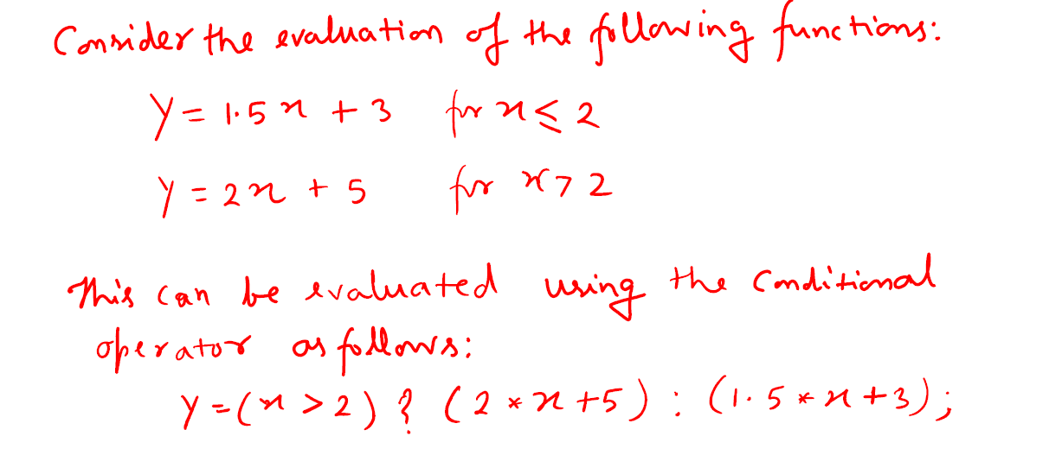

Slide 20
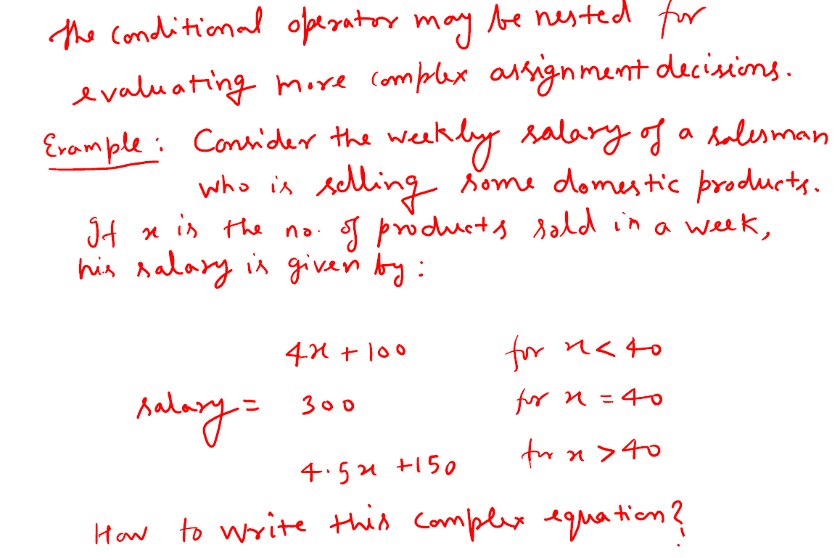

Slide 21
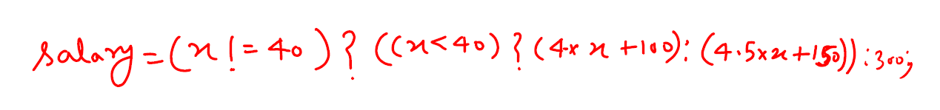

Slide 22
Bitwise operators
Operator | Meaning
& | Bitwise AND
I | Bitwise OR
^ | Bitwise exclusive OR
<< | Shift left
>> | Shift right
~ | Bitwise complement operator
Manipulate the data at bit level
May not be applied to float or double

Slide 23
Special operators
Comma operator: is used to link related expressions together. A comma-linked list of expressions are evaluated left to right and the value of right-most expression is the value of the combined expression. <comma operator has the lowest precedence of all operators>
E.g.
value = (x=10, y=5, x+y);
for (n=1, m=10; n<=m; n++, m++)
The sizeof operator
Returns the number of bytes the operand occupies
E.g.
m=sizeof(sum);
n=sizeof(long int);
sizeof operator is normally used to determine the lengths of arrays and structures when their sizes are not known to programmer. It is also used to allocate memory space dynamically to variables during execution of a program.

Slide 24
A Program to illustrate operators
main()
{
int a,b,c,d;
a=15;
b=10;
c=++a – b;
printf(“a=%d b=%d c=%d\n”,a,b,c);
d=b++ + a;
printf(“a=%d b=%d d=%d\n”,a,b,d);
printf(“a/b = %d\n”, a/b);
printf(“a%b = %d\n”, a%b);
printf(“a * b = %d\n”, a*=b);
printf(“%d\n”, (c>d) ? 1 : 0);
printf(“%d\n”, (c<d) ? 1 : 0);
}

Slide 25
Type Conversions in Expressions
If the operands are of different types, the ‘lower’ type is automatically converted to the ‘higher’ type before the operation proceeds. The result is of the higher type.
Implicit type conversion
Automatic conversion of intermediate values to proper type so that the expression can be evaluated without loosing any significance.
Explicit type conversion
Ratio=female_number/male_number;
Ratio=(float)female_number/male_number;

Slide 26
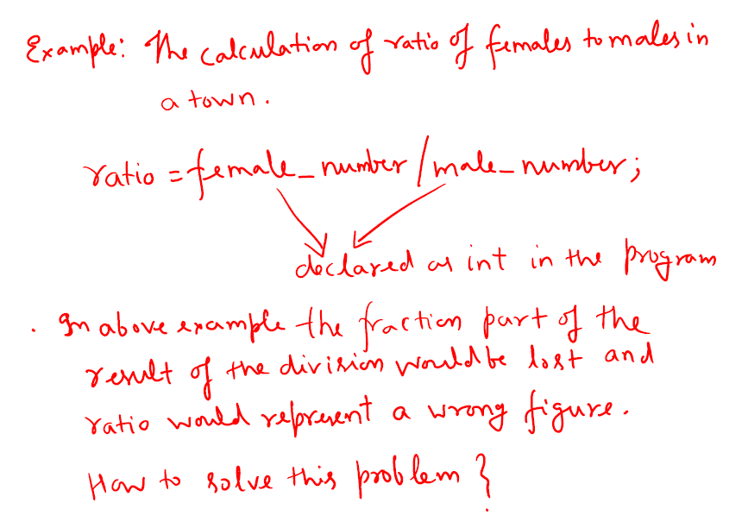

Slide 27
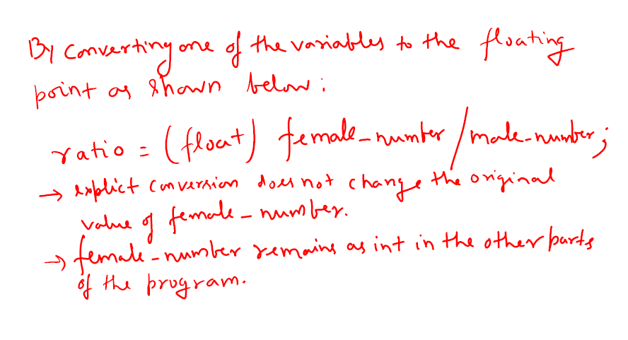

Slide 28
Assignment 2
Chapter 3 from E Balagurusamy
Exercise 3.1,3.2,3.3,3.4,3.5,3.6,3.7,3.8,3.9,3.10,3.11,3.12,3.13,3.14,3.18,3.20

Slide 29
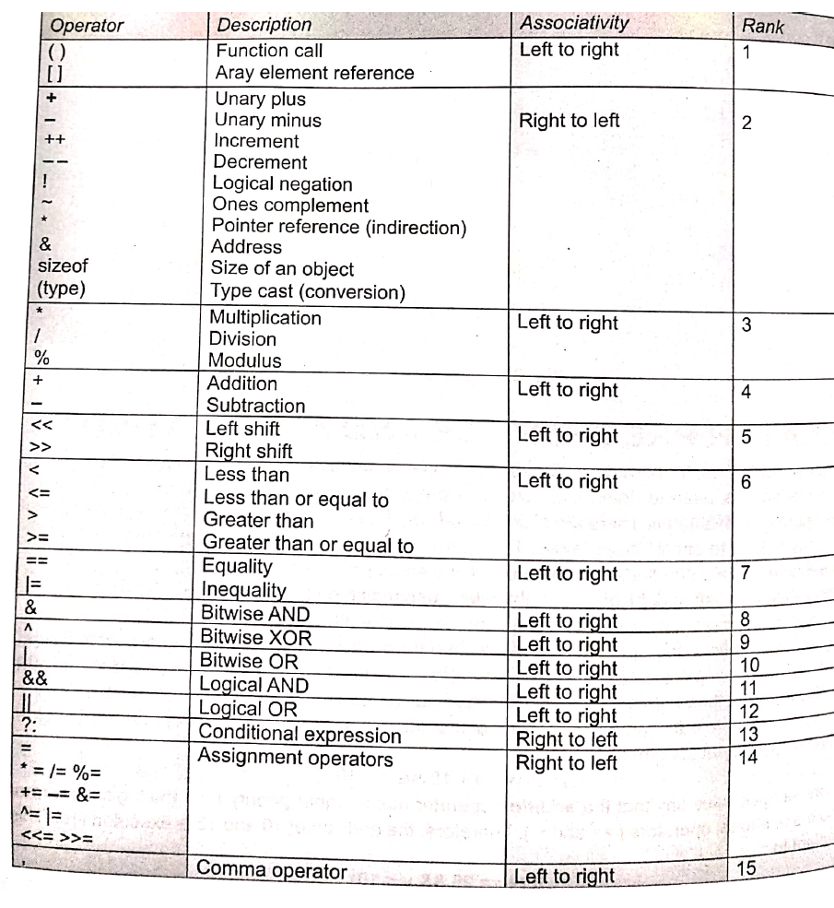
Precedence Order
Rules for Evaluation of Expression:
An arithmetic expression without parentheses will be evaluated from left to right using the rules of precedence of operators. There are two distinct priority levels of arithmetic operators in C. however expressions within the parentheses assume highest priority and evaluated from left to right.
High priority */%
Low priority +-
2. If parentheses are nested, the evaluation begins with the innermost sub-expression.
3. The associativity rule is applied when two or more operators of the same precedence level appear in a sub-expression.

Slide 30
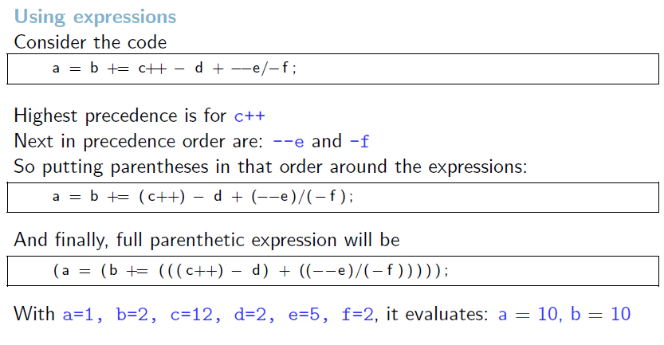
Precedence Order

